Slide 1
Managing Crisis: The role of Education and Young People
RRCS Youth Experience
Alexia RUBUGA, President of RRCS National Youth Council

Slide 2
Presentation outline
Summary presentation of the National Society
Discussions:
  Q1/: What do you see as threats and what were / are opportunities for young people during wars & crisis in Rwanda?
  Q2/: How does Rwanda RC Youth support other youth in crisis situations?
  Q3/: Is there any peer to peer support in crisis situation to young people for mental health and other needs?
Way forwards

Slide 3
1. Background of the National Society
Rwanda Red Cross Society was created in 1962 and officially instituted by Presidential decree of Dec 29, 1964
There is a decentralised structures chaired by elected governing boards : national level, district level, sector and cell level
There is a similar youth structure at all levels of decentralised structures
Red Cross is volunteer based organisation: over 60,000 members and volunteers
45% of members and majority of volunteers are active Youth volunteers
Volunteers operates through specialised teams: National emergency team, Branch emergency teams, local emergency teams (sector)
There is a close collaboration of RRCS structures with the government authorities & other stakeholders at national and decentralised levels: member of various platforms and working groups

Slide 4
2.1/ Threats and opportunities for young people during wars & crisis in Rwanda

Slide 5
Threats
  Rwanda has experienced the worst genocide in the history with deep and appalling consequences on youth: deaths, orphans, child headed households, street children, mental disorders …
  thousands of youths were arrested on charges they committed crimes of genocide at very young age
  The regional conflict situations has forced thousands of refugees to move across the boarders: over 100 thousands refugees in Rwanda (most of them young people and children). Youth are most affected : jobless, use of drugs, mental disorders …
  The Covid19 pandemic has also affected the living conditions youth: school dropouts, teenage pregnancies, increased drug abuse, loss of job opportunities, increased family conflicts ….

Slide 6
Threats
In general, Young people (both male and female) are vulnerable during conflicts times
  targeted potential recruitments to be rebels
  most targeted for GBV, hence they are most likely to be infected by IST and experience earlier pregnancies
  most experiencing mental health issues which drag them to drug abuse leading to the death.
Increasing involvement of children and young people in many of conflict-affected zones is an important area of concern for global security and the welfare of the younger generations: involvement in conflicts, hate speeches,
Increased exposure to increased intoxication through social media

Slide 7
Opportunities
  Young people gain skills quickly and they can use them to respond to their own: vocational training helped in gaining jobs and responding to their needs
  Increased engagement in volunteerism: youth are present in various initiatives targeting support to widows, old & lonely, orphans headed households …
  Increased participation in peace building initiatives through survivors associations
  They have tremendously worked to fight Covid19 within their communities

Slide 8
Opportunities
  Rwanda has adopted and customized the international protection system, and this results in substantial progress in the protection of children and youth with regard to armed conflict and other situations of emergency.
  The country has already reached a consensus concerning the establishment of a unified policy to address youth in conflict, as in the aftermath of the genocide against the Tutsi, the young ones were sent back to school and the labour laws start a practical prohibition of child labour and workforce
  There are increased opportunities for access to education (12 years basic education, vocational training)
  There are increased programs of awareness and civic education targeting the youth

Slide 9
2.2/: How does Rwanda RC Youth support other youth in crisis situations?

Slide 10
Various initiatives of RRCS Youth supporting other Youth
  The peace building Youth Action programs are implemented in Red Cross youth sections in schools and this encourages youth and young adults to learn about the rules of armed conflict and empowers them to explore international humanitarian law through peer-to-peer campaigns.
  There are regular Psychological First Aid Interventions during commemoration events for genocide countrywide
  Besides, during the years of the pandemic Rwanda Red Cross youth worked hand in hand with government youth volunteers on the forefront of the programs developed to stop the spread of the pandemic
  The hotline established during Covid19 helped in disseminating information and addressing the psychosocial issues
  Refugee response program: prevention of gender based violence, vocational training …

Slide 11
Examples of Volunteers’ interventions during Covid19 response and other crisis

Slide 12
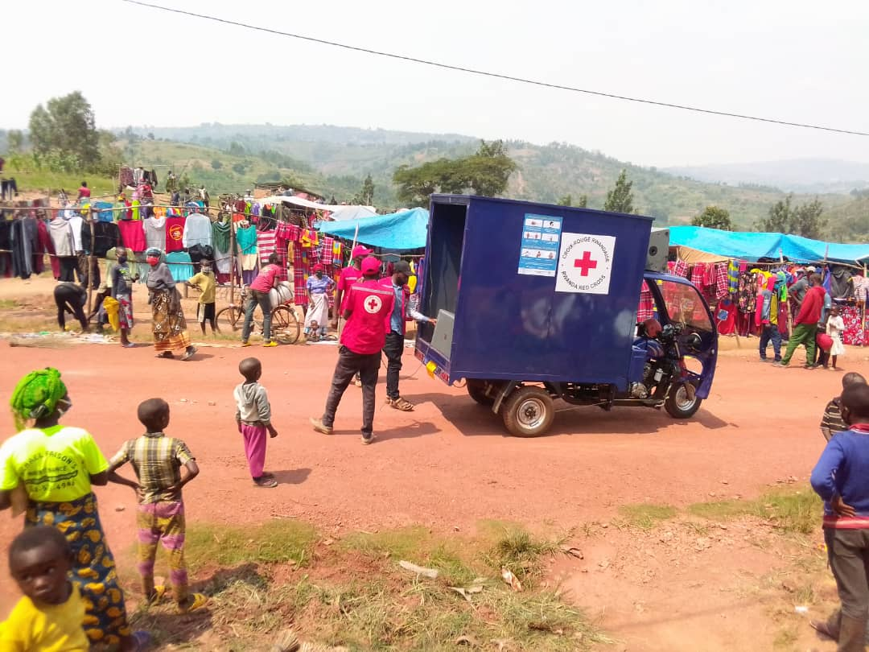
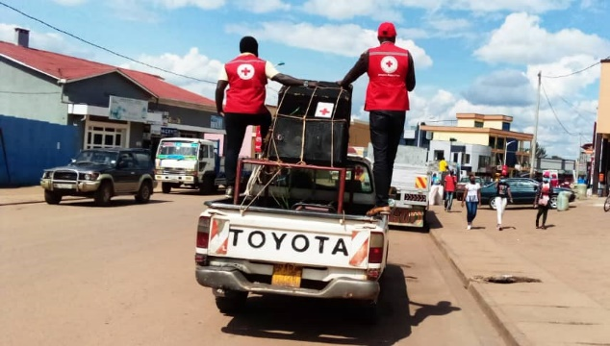
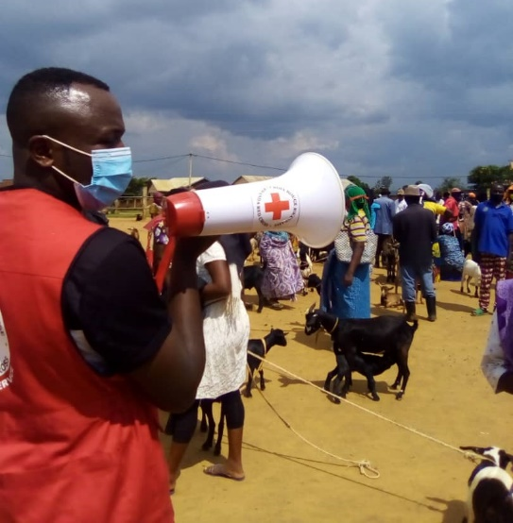
Risk Communication and Community Engagement activities conducted by volunteers
Multiple Covid19 prevention campaigns to disseminate knowledge on the pandemic and prevention measures: over 19.7 million people reached (cumulative)
Over 1 million people reached to address Covid19 vaccine hesitancy and through frequent rumour tracking exercises, to inform the mobilisation messages
Active mobilisation on Covid19 vaccination activities and support the vaccination activities
Multiple communication tools used: mobile radio, megaphones, radio talks, posters, ….

Slide 13
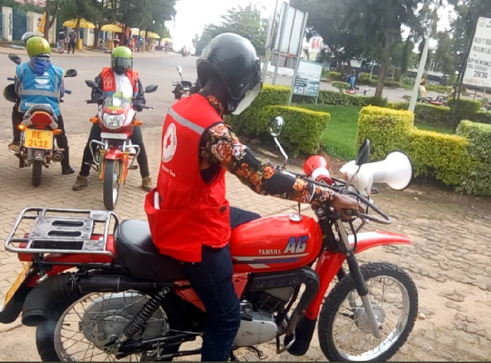
Youth were at the forefront of Covid19 response with Community mobilisation and support
Using megaphones, radio talks in order to disseminate the Covid19 prevention messages

Slide 14
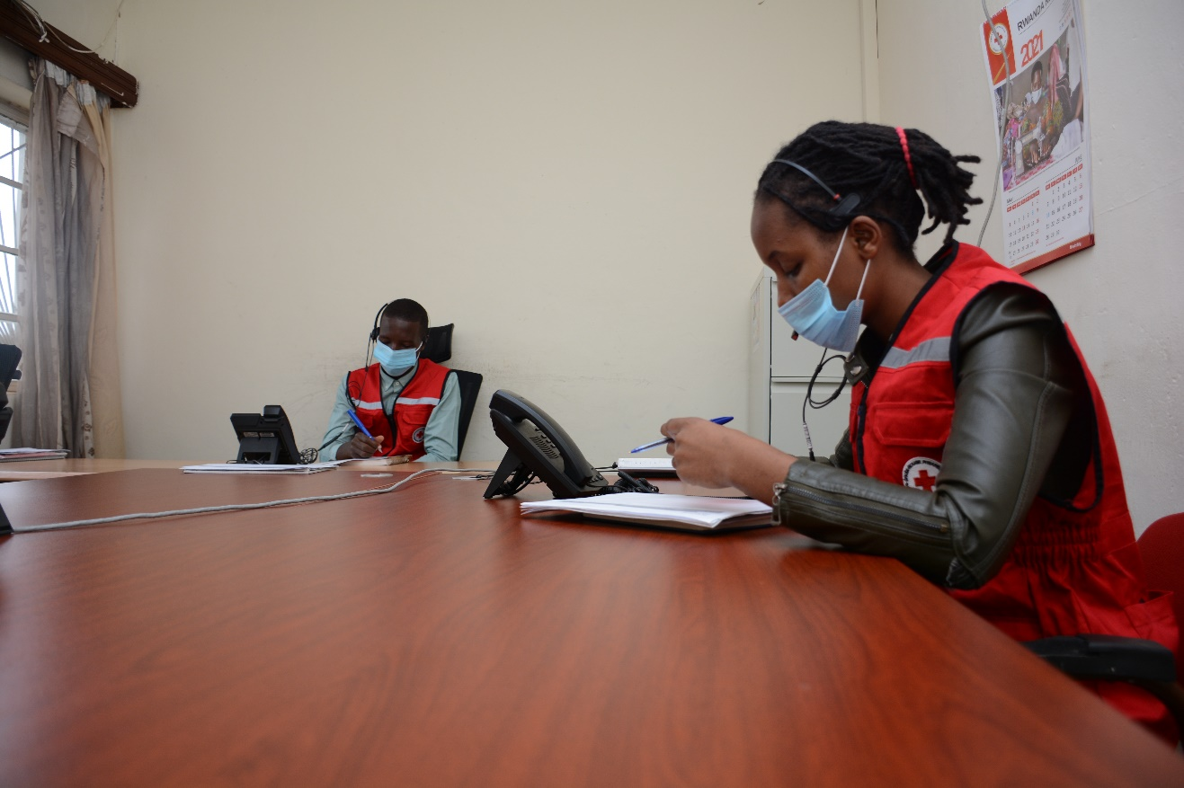
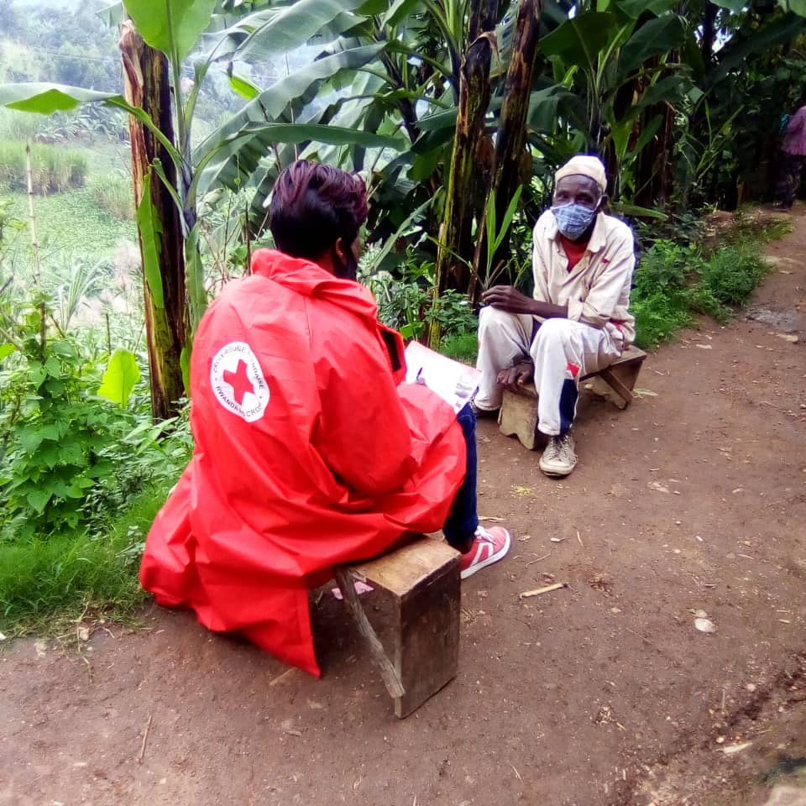
A call centre was established at RRCS HQ with aim of providing information and other required feedbacks on Covid19: 10 – 15 calls handled every day.
In addition, youth volunteers were engaged in PSS at community level: over 1 million reached with PSS intervention through home visits by volunteers

Slide 15
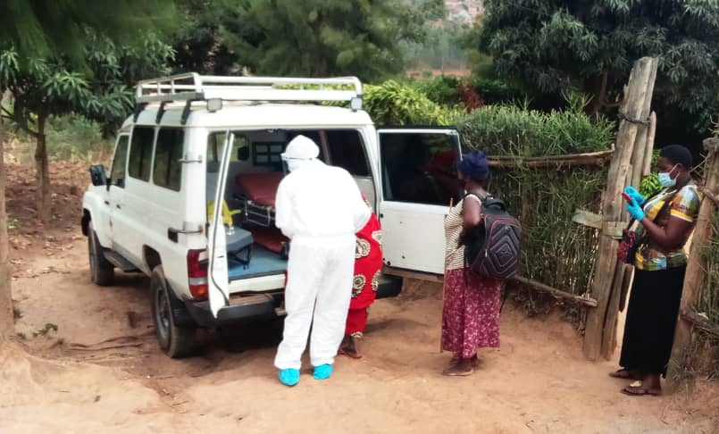
Provision of Ambulance services through trained Emergency medical technicians
Since July 2021, 592 Covid19 cases transported through 2 National Society’s ambulances stationed at the National Command Post / Kigali to support Ministry of Health
7 drivers and 9 nurses are continuously committed to this activity

Slide 16
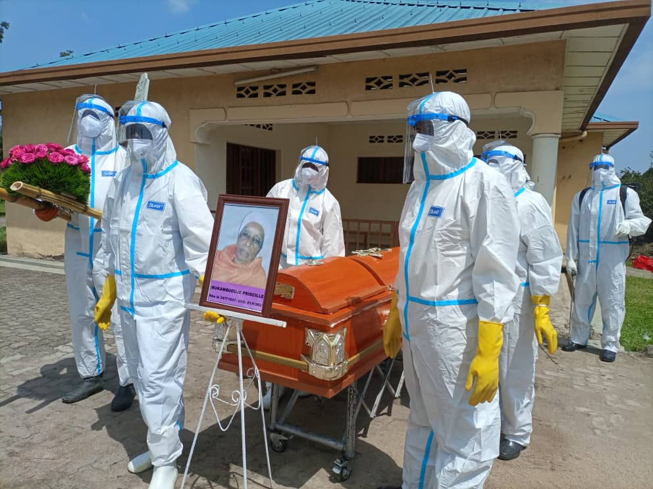
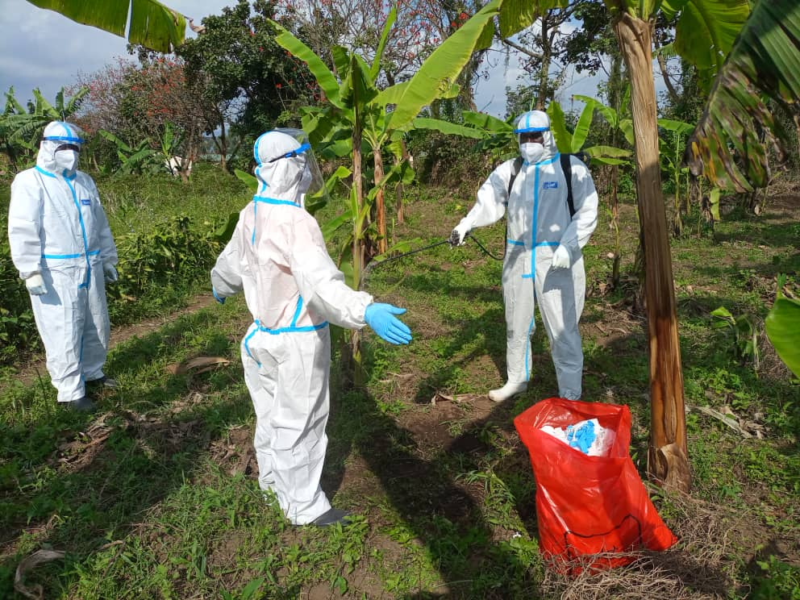
Support for Safe Burial conducted by volunteers across the country
Trained RRCS teams supported safe burial across the country: estimated 40% of the Covid19 victims’ burials were facilitated by trained RRCS volunteers

Slide 17
2.3/: Is there any peer to peer support in crisis situation to young people for mental health and other needs?

Slide 18
Peer to peer support initiatives
  The RRCS youth sections in schools are supporting their colleagues in peace building initiatives and responding to mental issues
  RRCS organise youth camps bringing together youth from various backgrounds, for education awareness and initiative to support other youth: this is a peer to peer initiative to address mental issues
  In refugee response programs, youth volunteers from refugees and those from host communities are working closer to support their colleagues: the sports and other recreation activities help in addressing mental health issues; home visits are also conducted
  There are youth friendly centres that help the youth to meet together and share their experiences and supporting each

Slide 19
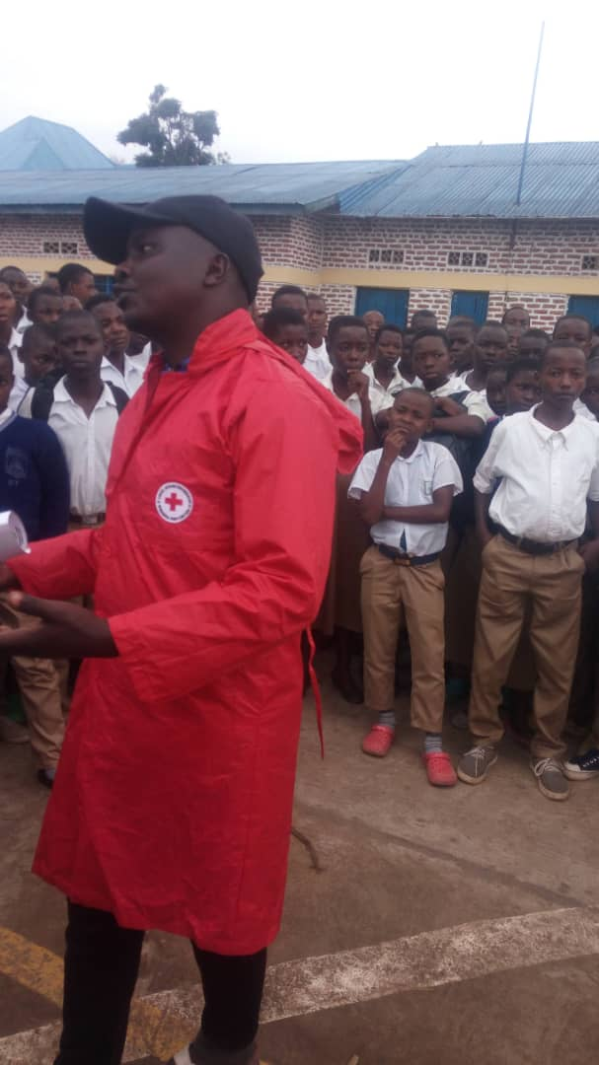
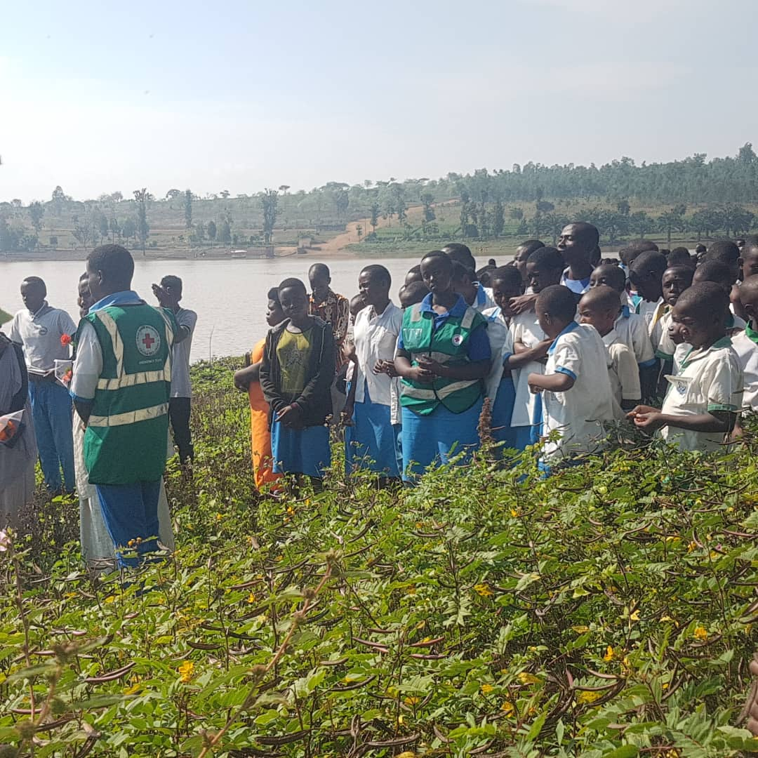
Peace building initiatives among the Youth done by other youth
Youth volunteers supporting their peers during commemoration events

Slide 20
3. Way Forwards
  Increase the training among the youth volunteers in order to strengthen the PSS skills
  Strengthen the RRCS humanitarian centre in order to promote culture of peace and social cohesion among the youth
  Strengthen the peer to peer support initiatives among the youth in order to address the mental health issues
  Networking with other organisation to address the mental health issues among the youth and prevention of gender based violence

Slide 21
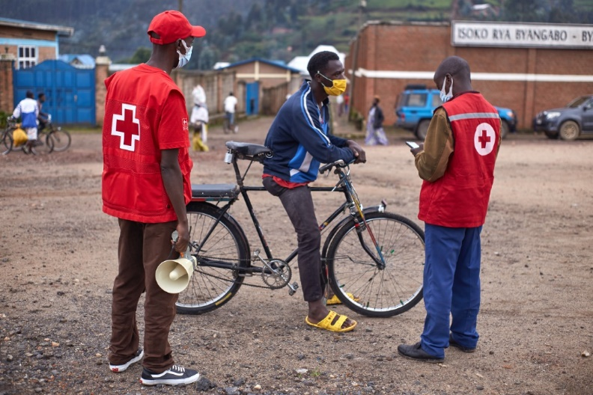
Together, we are stronger!

